Slide 1

PCWG 2016 Roadmap
PCWG Meeting Hamburg
10th March 2016
Peter Stuart (RES), on behalf of the Power Curve Working Group

Slide 2
PCWG Roadmap Preparation Process
Online Survey (November 2015)
Online Survey Results Presentation and Group Discussion (December 2015)
Preparation of roadmap based on survey results and discussion (January 2016)
Circulation of Draft Roadmap (February 2016)
Email Feedback (February 2016)
Roadmap Finalised (March 2016)

Slide 3
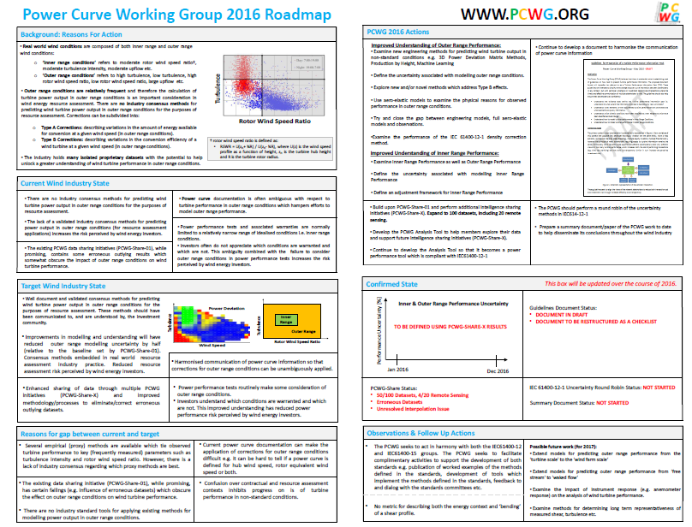

Slide 4
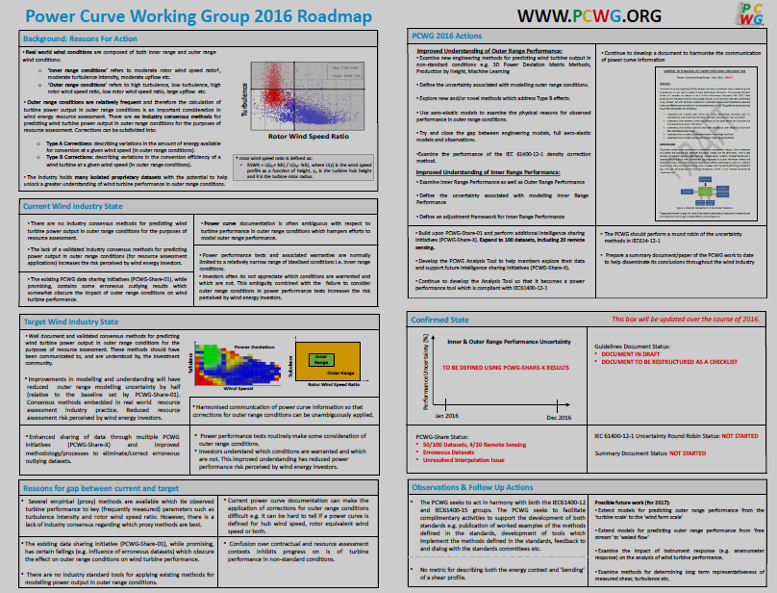
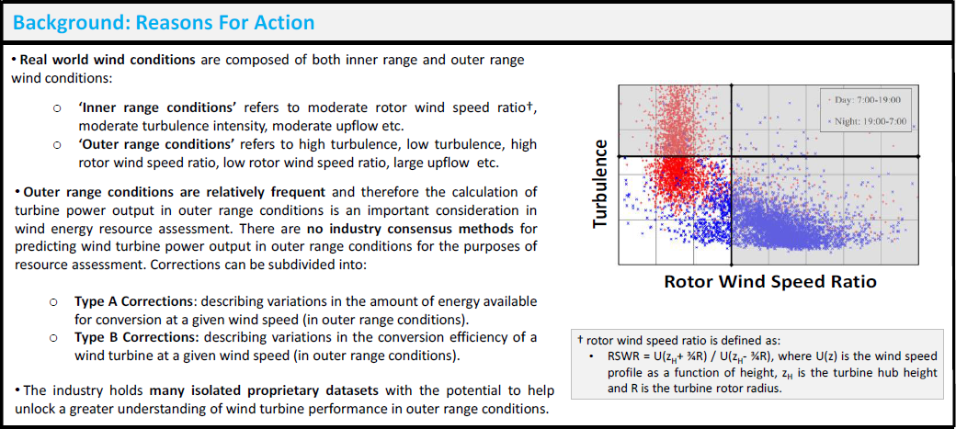

Slide 5
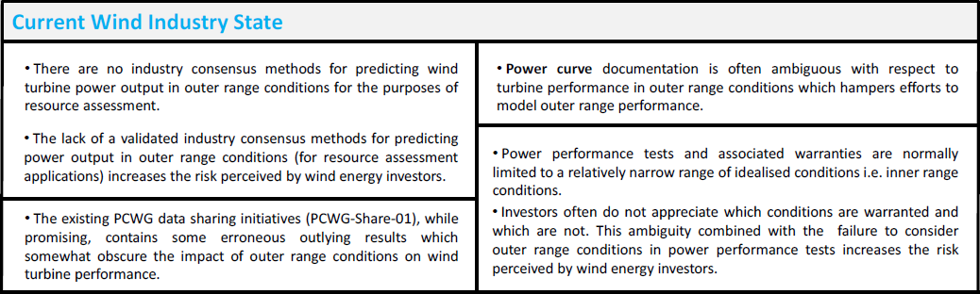

Slide 6
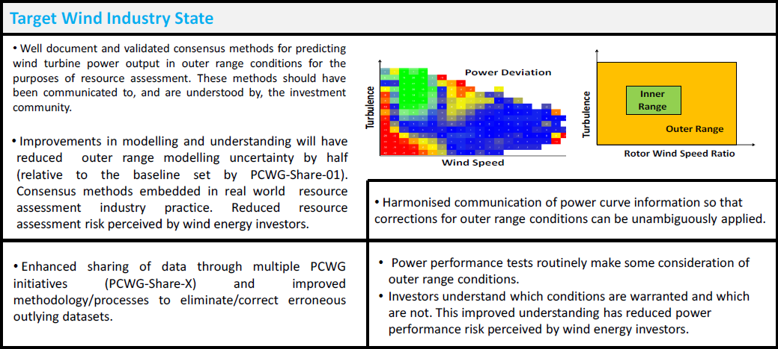

Slide 7
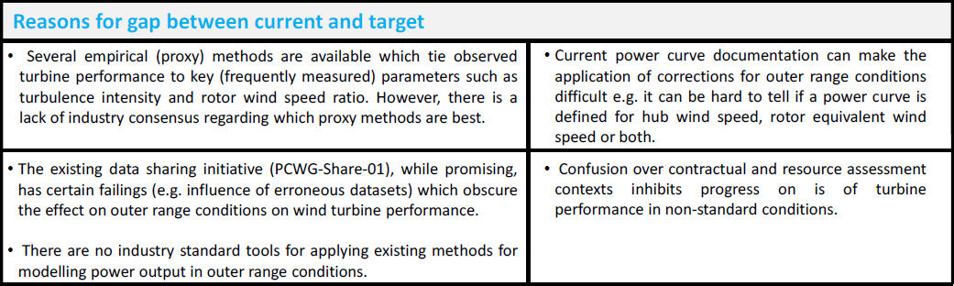

Slide 8
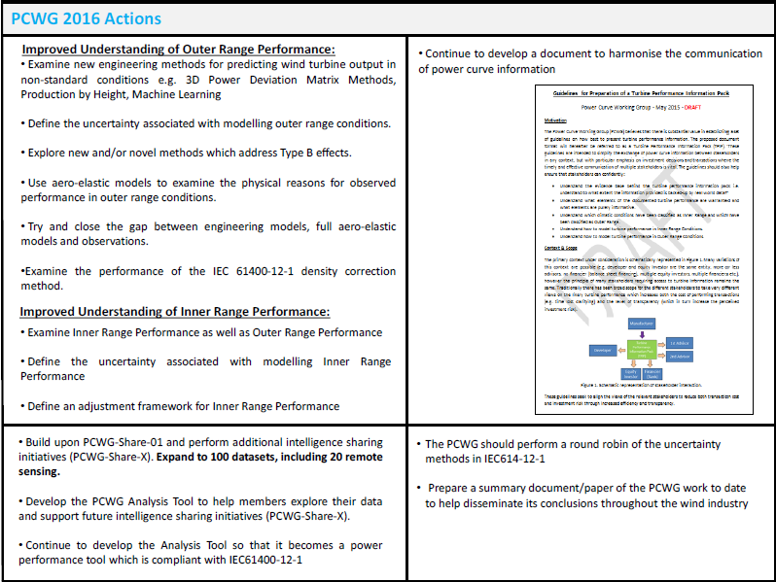

Slide 9
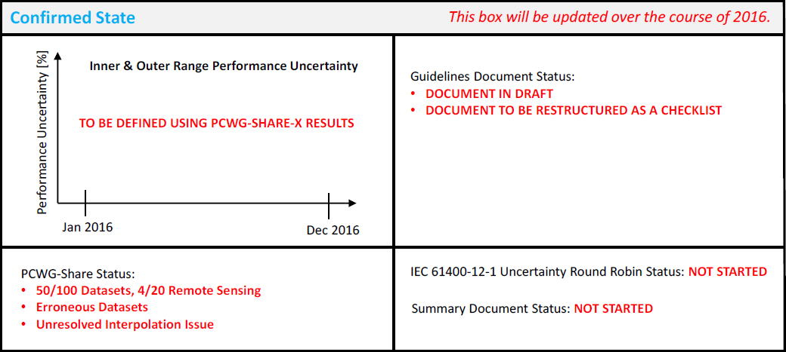

Slide 10
